Slide 1
VQ-VAE

Slide 2
Vector Quantized Variational Autoencoder
A Vector Quantized Variational Autoencoder is a type of neural network architecture that combines elements of variational autoencoders (VAEs) and vector quantization to learn discrete representations of data.
It is particularly useful for applications where discrete or categorical representations are beneficial
Encoder
Decoder
Input
Input
Quantization

Slide 3
Vector Quantized Variational Autoencoder
Input
Similar to a traditional VAE, VQ-VAE has an encoder network that takes input data and maps it to a continuous latent space.
However, unlike a standard VAE, the encoder in VQ-VAE does not output continuous values.
Instead, it outputs discrete codes that correspond to specific entries in a codebook.
Encoder
Entry 0
0.15
0.71
0.34
0.31
0.19
0.75
Quantization
Entry 1
0.17
0.76
0.82
0.17
0.82
0.84
Entry 2
0.89
0.92
0.56
0.72
0.43
0.94
Entry 3
0.38
0.75
0.90
0.17
0.06
0.69
2
0
1
2
3

Slide 4
VQ-VAE Encoder
The continuous representation from the encoder is reshaped into a matrix with the same number of columns as the dimension of the codebook and the same number of rows as the desired number of codes for encoding.
···
Encoder
···
Input
···
···
···
···
···
···
···
···

Slide 5
VQ-VAE Encoder: Quantization (1)
Each row of this matrix is compared with the rows of the codebook, and the closest matching codebook entry is selected based on the distance between the rows.
0.16
0.75
0.81
0.12
0.81
0.90
1
Compare and select
0.41
0.76
0.82
0.17
0.01
0.72
3
0.15
0.70
0.33
0.30
0.21
0.76
0
0.15
0.71
0.34
0.31
0.19
0.75
0.17
0.76
0.82
0.17
0.82
0.84
0.89
0.92
0.56
0.72
0.43
0.94
0.38
0.75
0.90
0.17
0.06
0.69

Slide 6
VQ-VAE Encoder: Quantization (2)
0.16
0.75
0.81
0.12
0.81
0.90
0.80
0.08
1.06
0.81
1
0.41
0.76
0.82
0.17
0.01
0.72
0.59
0.85
0.92
0.10
argmin
3
0.15
0.70
0.33
0.30
0.21
0.76
0.02
0.80
0.96
0.65
0
0.15
0.17
0.89
0.38
0.71
0.76
0.92
0.75
0.34
0.82
0.56
0.90
In PyTorch, the function used to calculate the distance matrix between two matrices is called cdist
0.31
0.17
0.72
0.17
0.19
0.82
0.43
0.06
0.75
0.84
0.94
0.69

Slide 7
VQ-VAE Decoder
Input
The decoder is responsible for generating data samples from discrete codes produced by the encoder and codebook.
It takes these discrete codes, looks up corresponding entries in the codebook, and maps them back to the original data space to reconstruct or generate data points.
Decoder
De-quantization
Codes

Slide 8
VQ-VAE Decoder
1
0.17
0.76
0.82
0.17
0.82
0.84
Select rows
3
0.38
0.75
0.90
0.17
0.06
0.69
0
0.15
0.71
0.34
0.31
0.19
0.75
0.15
0.71
0.34
0.31
0.19
0.75
0.17
0.76
0.82
0.17
0.82
0.84
0.17
0.76
0.82
···
0.31
0.19
0.75
0.89
0.92
0.56
0.72
0.43
0.94
0.38
0.75
0.90
0.17
0.06
0.69
Decoder

Slide 9
Putting all together
These operations are not differentiable
Encoder
0.16
0.75
0.81
0.12
0.81
0.90
Input
Compare and select
···
0.41
0.76
0.82
0.17
0.01
0.72
0.15
0.70
0.33
0.30
0.21
0.76
0.15
0.71
0.34
0.31
0.19
0.75
0.17
0.76
0.82
0.17
0.82
0.84
Codes
0.89
0.92
0.56
0.72
0.43
0.94
0.38
0.75
0.90
0.17
0.06
0.69
Decoder
0.17
0.76
0.82
0.17
0.82
0.84
Input
Select rows
···
0.38
0.75
0.90
0.17
0.06
0.69
0.15
0.71
0.34
0.31
0.19
0.75

Slide 10
VQVAE: quantization trick
Input
0.16
0.75
0.81
0.12
0.81
0.90
Encoder
0.41
0.76
0.82
0.17
0.01
0.72
x is produced by
the encoder
x
0.15
0.70
0.33
0.30
0.21
0.76
···
0.17
0.76
0.82
0.17
0.82
0.84
0.15
0.71
0.34
0.31
0.19
0.75
q
0.38
0.75
0.90
0.17
0.06
0.69
q is composed by
elements of the codebook
0.17
0.76
0.82
0.17
0.82
0.84
0.15
0.71
0.34
0.31
0.19
0.75
0.89
0.92
0.56
0.72
0.43
0.94
0.38
0.75
0.90
0.17
0.06
0.69
We want to transform x into q while retaining a path to the encoder in the CG

Slide 11
VQVAE: quantization trick
(q - x).detach() + x
0.17
0.76
0.82
0.17
0.82
0.84
0.38
0.75
0.90
0.17
0.06
0.69
-
+
0.15
0.71
0.34
0.31
0.19
0.75
q
Encoder
0.16
0.75
0.81
0.12
0.81
0.90
Input
0.41
0.76
0.82
0.17
0.01
0.72
x
0.15
0.70
0.33
0.30
0.21
0.76
x

Slide 12
Training objectives
When the encoder “chooses” a vector
it should commit to that
Encoder
0.16
0.75
0.81
0.12
0.81
0.90
Input
Compare and select
···
0.41
0.76
0.82
0.17
0.01
0.72
0.15
0.70
0.33
0.30
0.21
0.76
Vectors in the codebook
should be closer to ones
produced by the encoder
0.15
0.71
0.34
0.31
0.19
0.75
0.17
0.76
0.82
0.17
0.82
0.84
Codes
0.89
0.92
0.56
0.72
0.43
0.94
Reconstruction should be good
0.38
0.75
0.90
0.17
0.06
0.69
Decoder
0.17
0.76
0.82
0.17
0.82
0.84
Input
Select rows
···
0.38
0.75
0.90
0.17
0.06
0.69
0.15
0.71
0.34
0.31
0.19
0.75

Slide 13
Training objectives
Reconstruction loss
Trains the model (encoder and decoder) to minimize the discrepancy between the original input data and the reconstructed output data, encouraging the model to learn a meaningful and faithful representation of the input in the latent space.
Codebook loss
Trains the codebook to have vectors closer to the ones produced by the encoder, promoting the creation of a codebook that captures the essential information in the data and encourages the model to utilize the codebook entries effectively during the quantization proces
Commitment loss
Trains the encoder to produce vectors closer to the ones in the codebook, ensuring that each data point's latent representation is strongly associated with a single codebook entry, thus improving the efficiency of the learned representations.

Slide 14
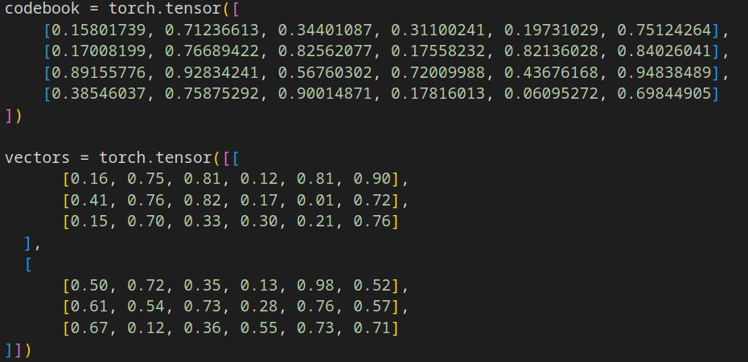
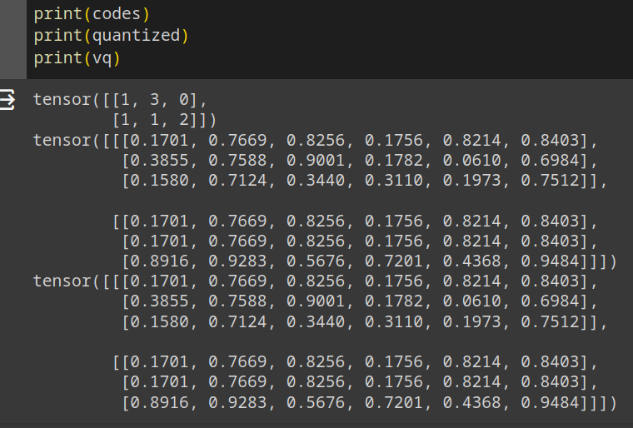
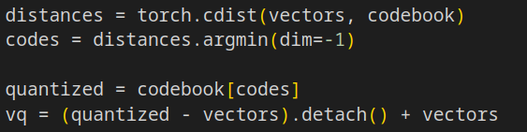
VQVAE: PyTorch

Slide 15
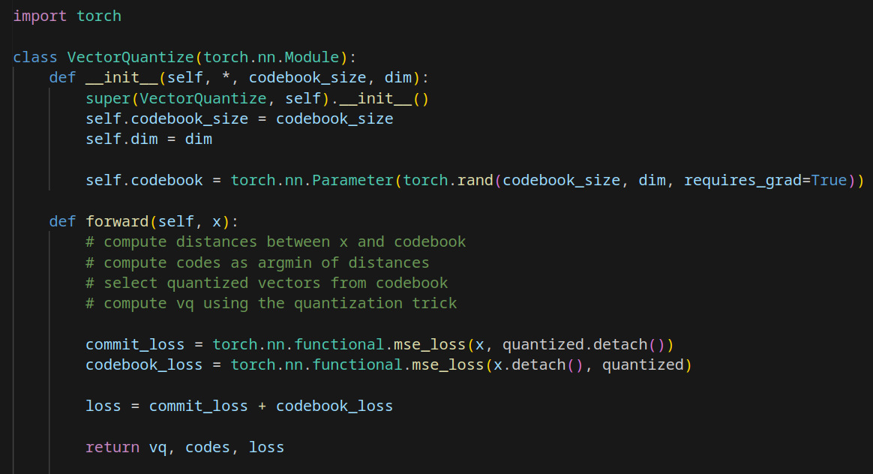
VQVAE: PyTorch

Slide 16
vector-quantize-pytorch library
vector-quantize-pytorch is a Python library and implementation that facilitates the use of Vector Quantized Variational Autoencoders (VQ-VAEs) in PyTorch.
It contains the implementation of various vector quantization methods:
Residual VQ: Implements a method from a paper where multiple vector quantizers recursively quantize the residuals of the waveform​
RQ-VAE: Another paper's approach uses Residual-VQ to generate high-resolution images with more compressed codes. It introduces sharing the codebook across all quantizers and stochastically sampling codes rather than always taking the closest match​
Grouped Residual VQ: A recent paper proposes doing residual VQ on groups of the feature dimension, achieving results comparable to Encodec with fewer codebooks​
KMeans Initialization: The SoundStream paper suggests initializing the codebook with the kmeans centroids of the first batch, a feature available in both VectorQuantize and ResidualVQ classes​

Slide 17
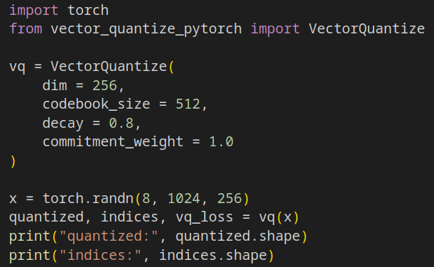

vector-quantize-pytorch library
To use the VectorQuantize module:
To install vector-quantize-pytorch:
You dont need to worry about
commitment loss and codebook loss

Slide 18
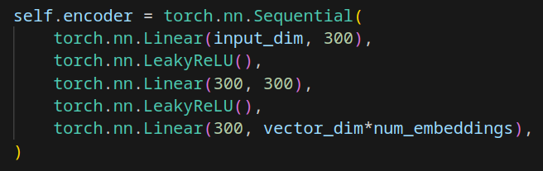
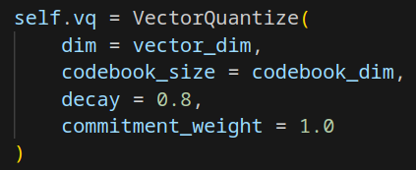
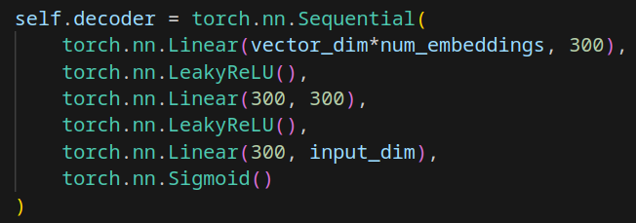
Exercise 1
Train a VQ-VAE on the MNIST dataset using the vector-quantize-pytorch implementaion of the quantization layer
Use MLP as encoder and decoder
Plot some inputs and their reconstruction
Plot some generated images from random codes

Slide 19
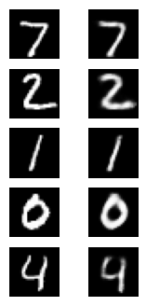
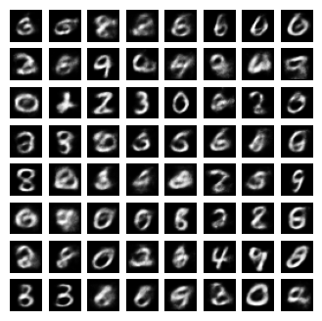
Exercise 2
Train a VQ-VAE on the MNIST dataset WITHOUT using the vector-quantize-pytorch implementaion of the quantization layer
Implement your own VectorQuantize class
Use MLP as encoder and decoder
Plot some inputs and their reconstruction
Plot some generated images from random codes

